Slide 1

Flying is safer than ever. Here's how we know.
Brandon Sams
Bellevue University

Slide 2
Flying is Terrifying
Claustrophobia
Fear of Heights
Fear of Flying Statistics (2020 Data). 4 Feb. 2020, https://www.stratosjets.com/blog/fear-of-flying-statistics-trends-facts/.

Slide 3
Common Statements about Flight Safety
"There was a 1 in 3.37 billion chance of dying in a commercial airline plane crash between 2012-2016."
"98.6% of crashes do not result in a fatality."
"Of the 140 plane accidents during 2012-2016, only two involved fatalities (1.4%)."
"Commercial plane incidents cause death only once in 20 million flights."
Fear of Flying Statistics (2020 Data). 4 Feb. 2020, https://www.stratosjets.com/blog/fear-of-flying-statistics-trends-facts/.

Slide 4
Problems with these common statements about Flight Safety
Opportunity to cherry-pick (why 2012-2016?)
They neglect to show how this data is changing over time
They often rephrase the same information differently
Information overload
They tell the conclusion, not how the conclusion was reached
Trustworthiness

Slide 5

Where is this presentation going?
Start from Long-Term Data
Look at the numbers in 3 ways
Draw conclusions about how much safer flying has gotten over time
This Photo by Unknown Author is licensed under CC BY-NC

Slide 6
Long Term Data
Safety Metric | 1985-1999 | 2000-2014
Incidents | 402 | 231
Fatalities | 6295 | 3109
Fatal Accidents | 122 | 37
“Fivethirtyeight/Data.” GitHub, https://github.com/fivethirtyeight/data. Accessed 12 July 2020.

Slide 7
Incidents

Slide 8
Fatalities

Slide 9
Fatal Accidents

Slide 10
Well that sounds like great news!
No matter which way you measure it, flying has gotten safer over time.

Slide 11
Let’s Consider…
How many flights are there in a year?

Slide 12

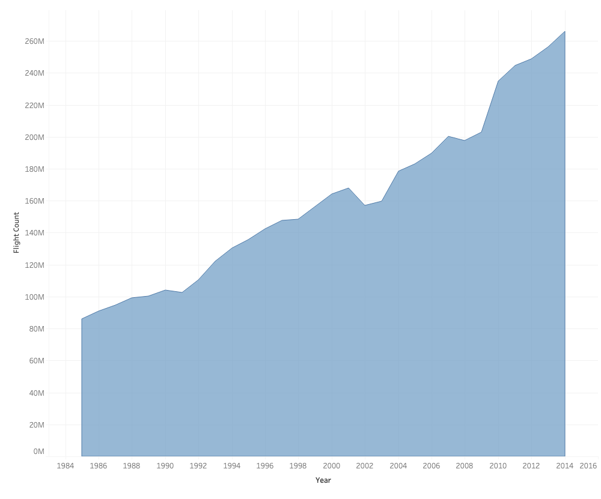
Flight Count
265 Million
1985-2014
86 Million
AIR TRANSPORT, REGISTERED CARRIER DEPARTURES WORLDWIDE | DATA. HTTPS://DATA.WORLDBANK.ORG/INDICATOR/IS.AIR.DPRT?END=2014&START=1985. ACCESSED 28 JUNE 2020.

Slide 13
So how much safer is flying?

